Slide 1
The Individual: Romanticism’s Core Proposal
Joy Badalis
Sophie Madril
I.H. English 12

Slide 2
Romanticism vs. Industrialism: Their Silent Battle
Stretching from about 1789-1832, the Romantic movement stressed emotion, intuition, and imagination.
Industrialism spanned from 1760-1850 during which the old manner of doing things was destroyed and signified an abrupt change from the old way.

Slide 3
New Thoughts
Romanticism:
Individual is the center of the universe
Industrialism:
Society is held above the individual
Hogarth, William. The Two Apprentices. 1747

Slide 4
The Basis for Satire: The Components of Romanticism
Romantic Individualism
“The individual is an expression of God” (Grimes n.pag)
Individualism
Advocated the independent, liberty and rights of the individual

Slide 5
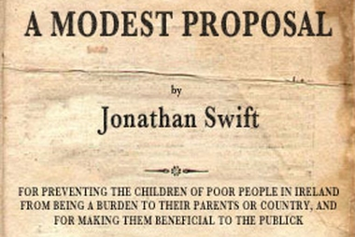
Strategy
Battle of the Thinkers and Doers:
Two children wonder why their respective communities have such animosity towards each other.
Two will explain their cultures and the differences between them
Thinkers: education is everything and to understand nature you much become one with nature
Doers: In order to succeed, you must help society grow as a whole.
Ends with an allusion from A Modest Proposal

Slide 6
The Thinkers ( exaggerated Romantics)
Peace in nature
Its ok to dream
Intuition, emotion, and imagination are highlighted
Supernatural > everyday humdrum
Key difference: Repelled by factories, cities, and general urban sprawl

Slide 7
The Doers (exaggerated Industrialists)
The most good for the most people
Work is a reflection of the inner character
Contributions build society
Science > supernatural
Surrounded but lonely
Key difference: Sought to create and build cities rather than allow nature to run its course

Slide 8
Works Cited (MLA)
Montagna, Joseph A. The Industrial Revolution. Yale-New Haven Teachers Institute. 2010. http://www.yale.edu/ynhti/curriculum/units/1981/2/81.02.06.x.html
Grimes, Dr. Geoffrey, A. “English 2327:Survey of American Literature”. Mountain View College: 2004. <http://www.distancelearningassociates
.com/eng2327/BC-Individualism.html>.
“Individualism." The American Heritage® Dictionary of the English Language, Fourth Edition. Houghton Mifflin Company, 2004. 11 May. 2010. < http://dictionary.reference.
com/browse/individualism>.

